Slide 1
Case Study 2
Group 3

Slide 2
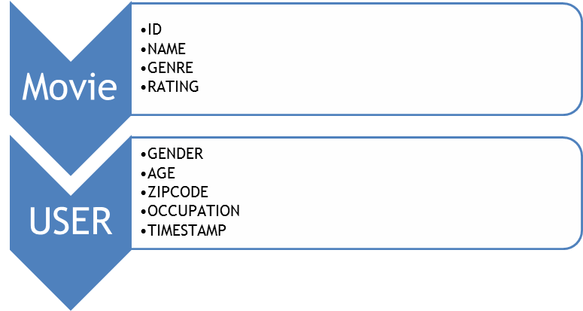
Understanding the Data Set
1 Million dataset
Age attribute was discretized
The timestamp attribute was also converted into date and time
Extract information from the zip code attribute in the table using the ‘geocoder’ library in Python, produced a lot of errors, missing values

Slide 3
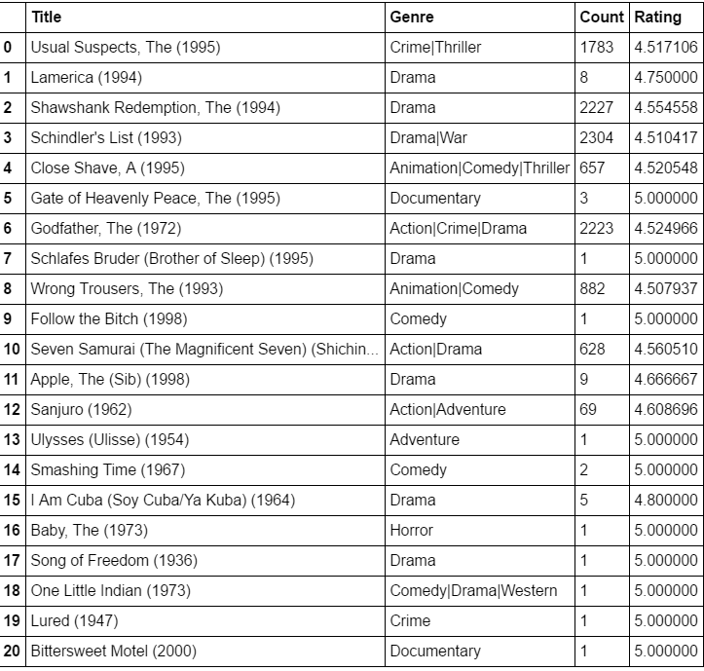
Movies with average rating of 4.5 and above
23
51
Females have rated more movies above 4.5.

Slide 4
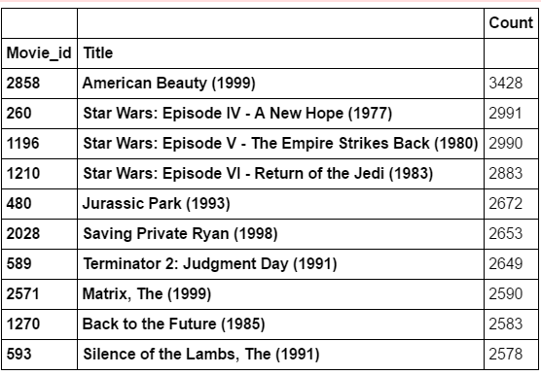
10 MOST POPULAR MOVIES
Count(Movie_id)

Slide 5
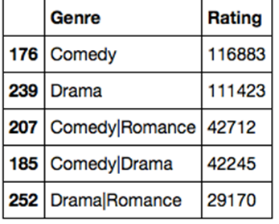
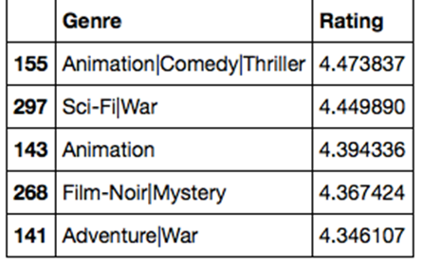
Insights from Dataset
Top 5 genre that were rated by maximum users
Possibility of bias in the data- users and bots
Top 5 Genre having an average highest ratings
sampling biases-users who rated movies high and ignore ones who rated low

Slide 6
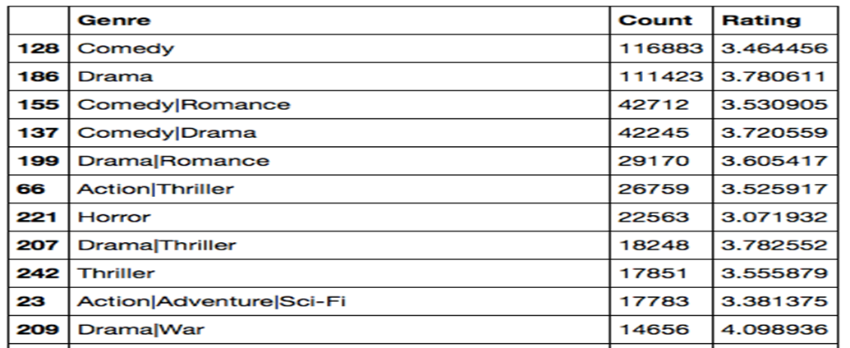
Insights from Dataset
To overcome these biases we use COUNT+RATING

Slide 7
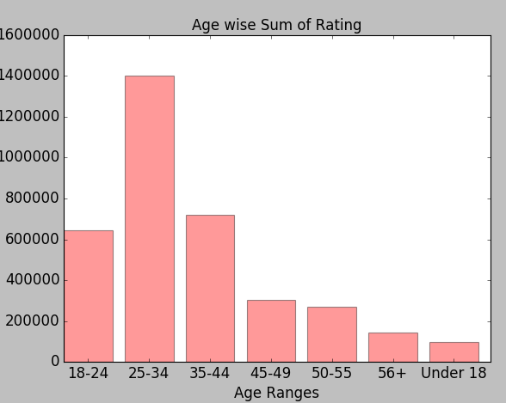
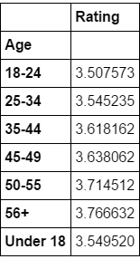
Insights from Dataset
People aged between 25-34, watch movies most
The average rating for this age group is 3.55

Slide 8
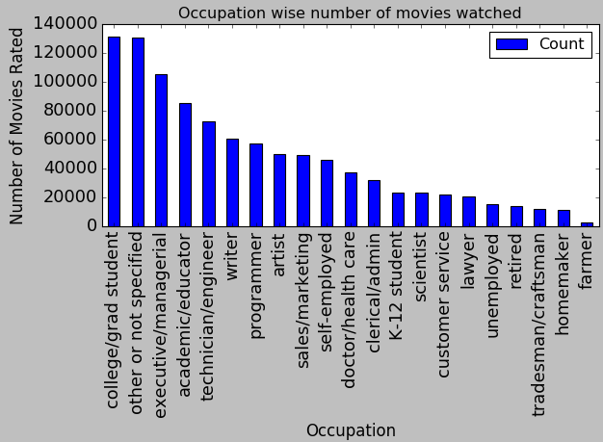
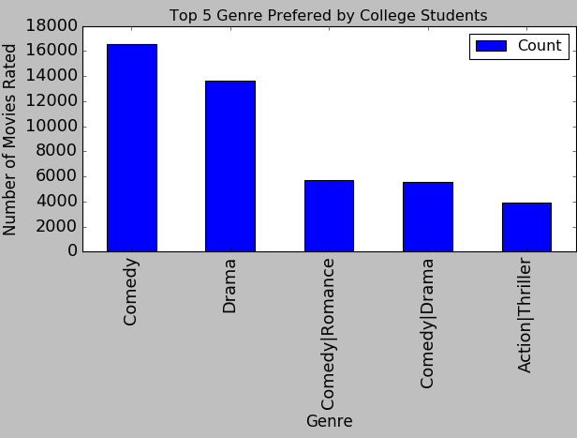
Insights from Dataset
Occupation wise, College students watch the movie most and Farmers the least
The most preferred genre by college students is Comedy followed by Drama

Slide 9
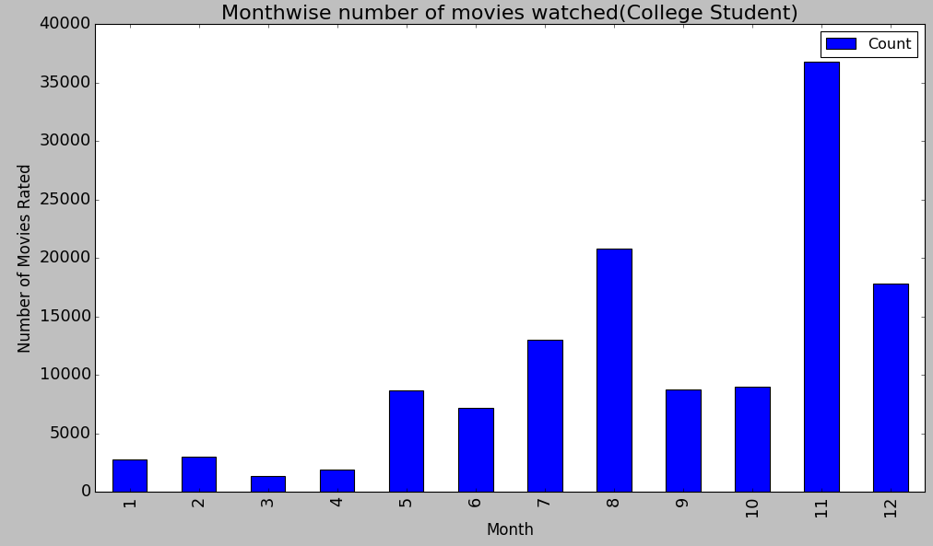
Insights from Dataset
Students tend to watch movies more in November month followed by August

Slide 10
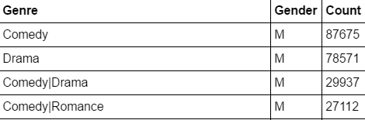
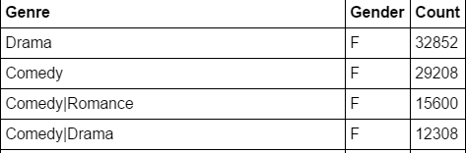
Insights from Dataset
Male VS Female Genre Preferences
MALE
COMEDY
FEMALE
DRAMA
DRAMA
COMEDY/DRAMA
COMEDY/ROMANCE
COMEDY
COMEDY/ROMANCE
COMEDY/DRAMA

Slide 11
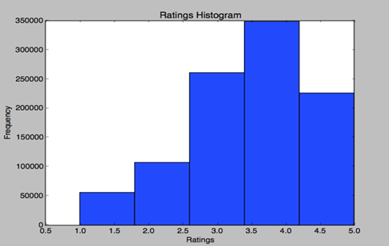
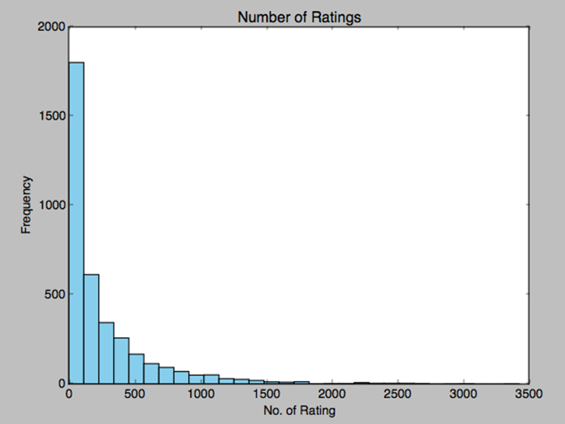
Inference from Histograms
Audience in general is not critical. Most movie ratings are between 2.5-5
Inconsistency in ratings as a lot of movies have few ratings.

Slide 12
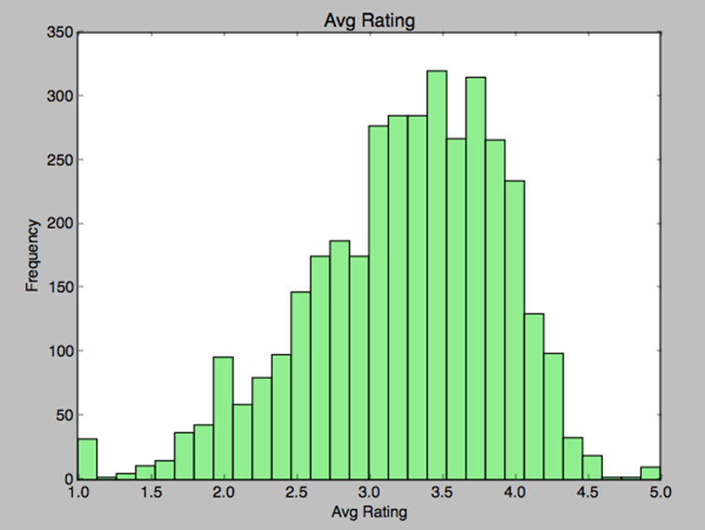
Inference from Histograms
Mean of the ratings for all movies
Gaussian distribution, with maximum amount of ratings between 3.0 - 4.0

Slide 13
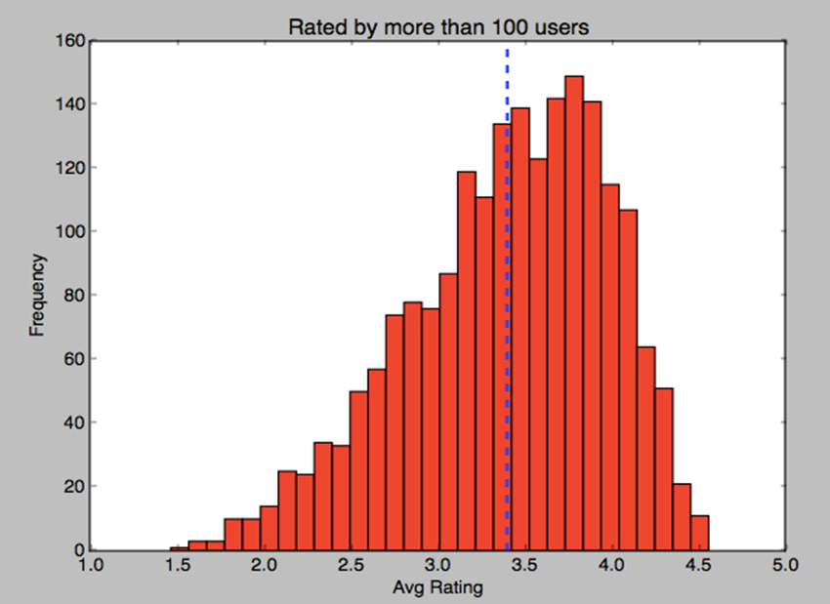
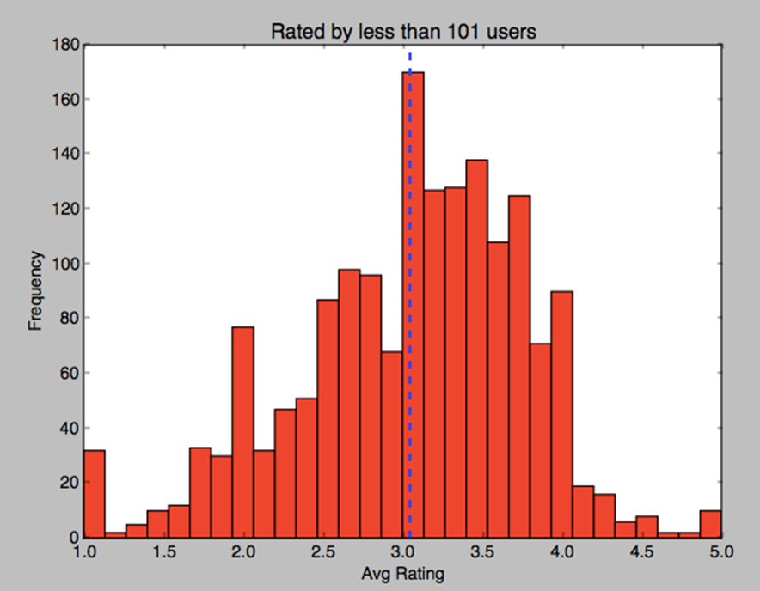
Inference from Histograms
A refined Gaussian curve is produced with a mean rating at about 3.4 is achieved here by filtering the data with ratings more than 100 users
Movies having below 101 users produces an irregular Gaussian distribution thus depicting inconsistencies with mean rating of 3.04
histograms are skewed to the left which conveys that the tail is on the left

Slide 14
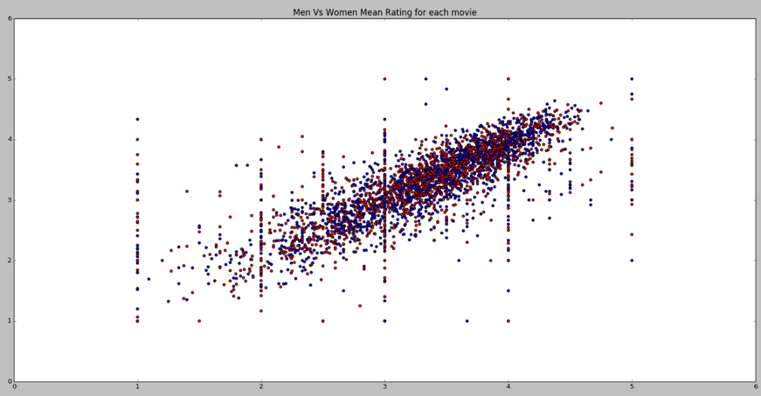
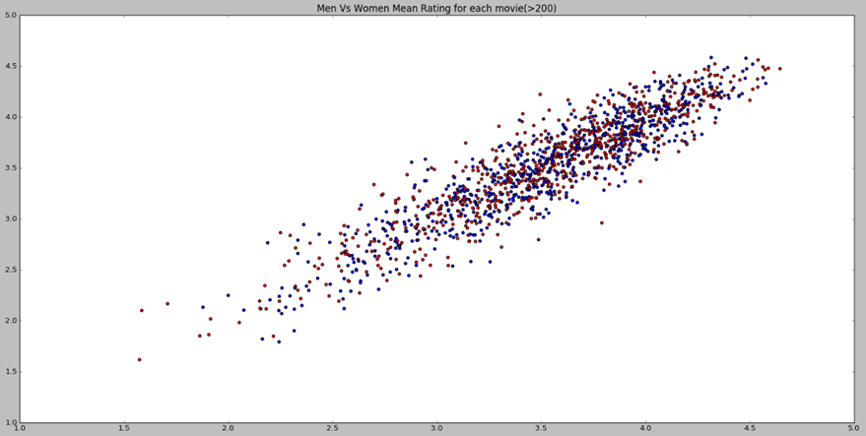
Inference from Scatter Plots- Men VS Women
Men versus Women and their mean rating for every movie, shows a linearly increasing trend
Men versus Women and their mean rating for movies rated more than 200 times, linear increasing trend

Slide 15
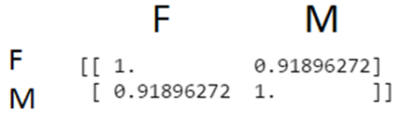

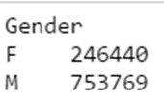
Inference from Scatter Plots- Men VS Women
The correlation coefficient shows that is high, men and women think alike when it comes to movies!!!
Average Rating overall for men and women,
average ratings are almost similar
Number of Movies Rated:, count of number of movies largely differ. Hence, we cannot accurately predict

Slide 16
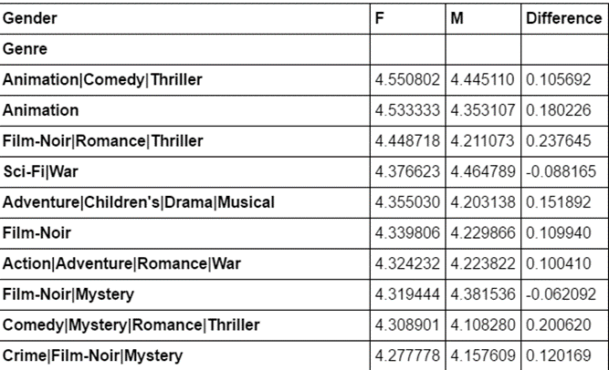
Inference from Scatter Plots- Men VS Women
These Genres are highly rated by men and women both, they prove the analysis by the scatter plots correct!

Slide 17
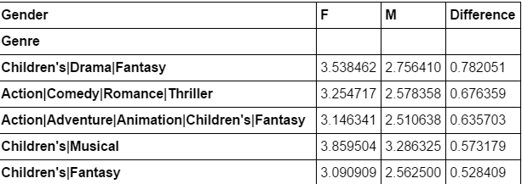

Inference from Scatter Plots- Men VS Women
These Genres are highly rated by men and women both, they prove the analysis by the scatter plots correct!
difference in Rating of genre is greater than 0.5, This value is not large enough though.

Slide 18
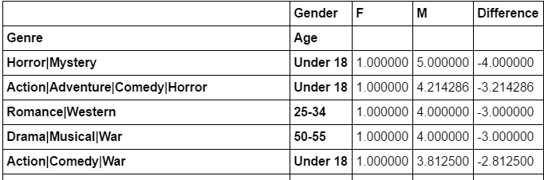
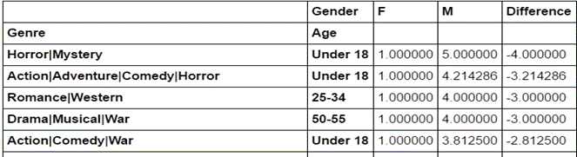
Inference from Scatter Plots- Men VS Women
Average Rating group by Genre and Age: Elders tend to like Comedy|Horror|Sci-Fi movies

Slide 19
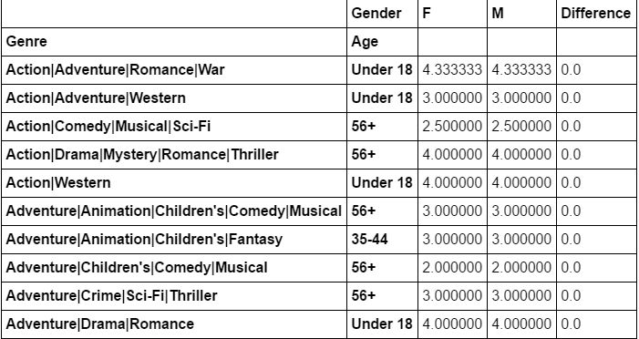
Inference from Scatter Plots- Men VS Women
Similarity compared to similar liking

Slide 20
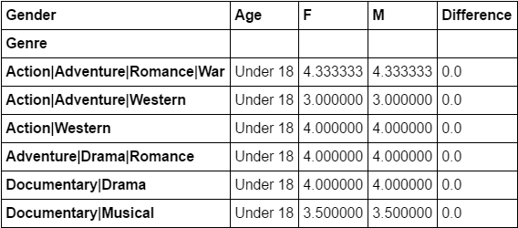
Inference from Scatter Plots- Men VS Women
These are the Genres where Male and Female have similar views if their age is Under 18

Slide 21
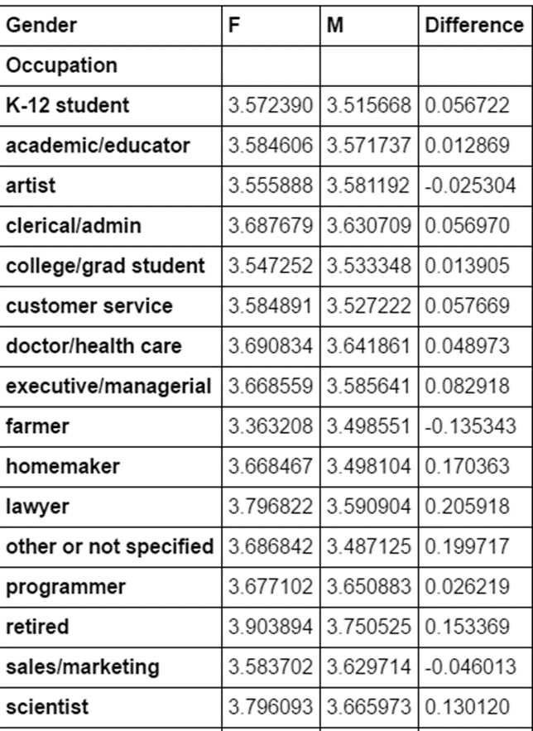
Inference from Scatter Plots- Men VS Women
Occupation wise Average Rating Trend of Male and Female:

Slide 22
Business Question
Market-wise Customer Segmentation by Smart selection of the Target Audience. Analysis is to be done to find out the best Package to Target User using Data Science which can increase the loyalty of customer towards the company or increase the profit.

Slide 23
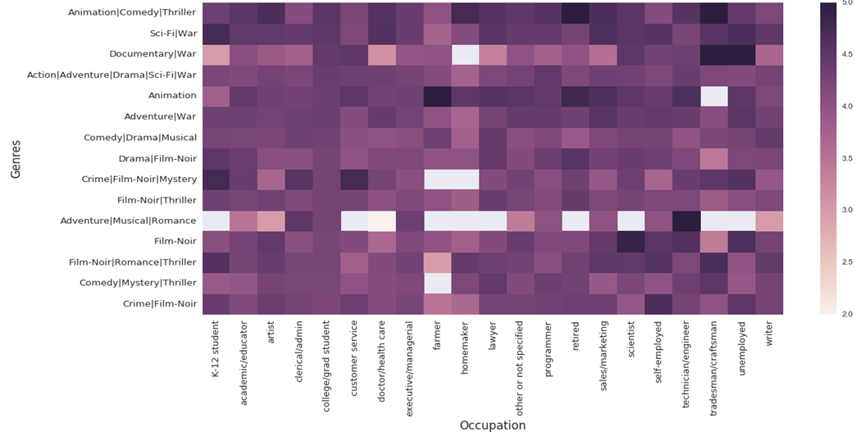
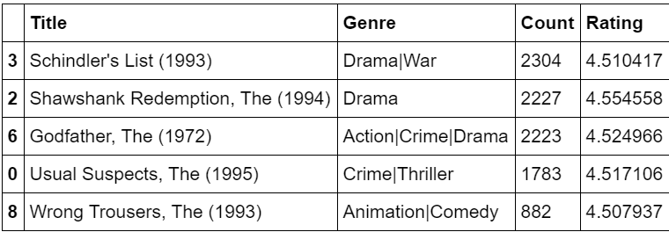
Business Question
Movies which has overall rating over 4.5, be recommended or should be part of package that we will suggest to target audience
relationship between Occupation and Genres of Movies

Slide 24
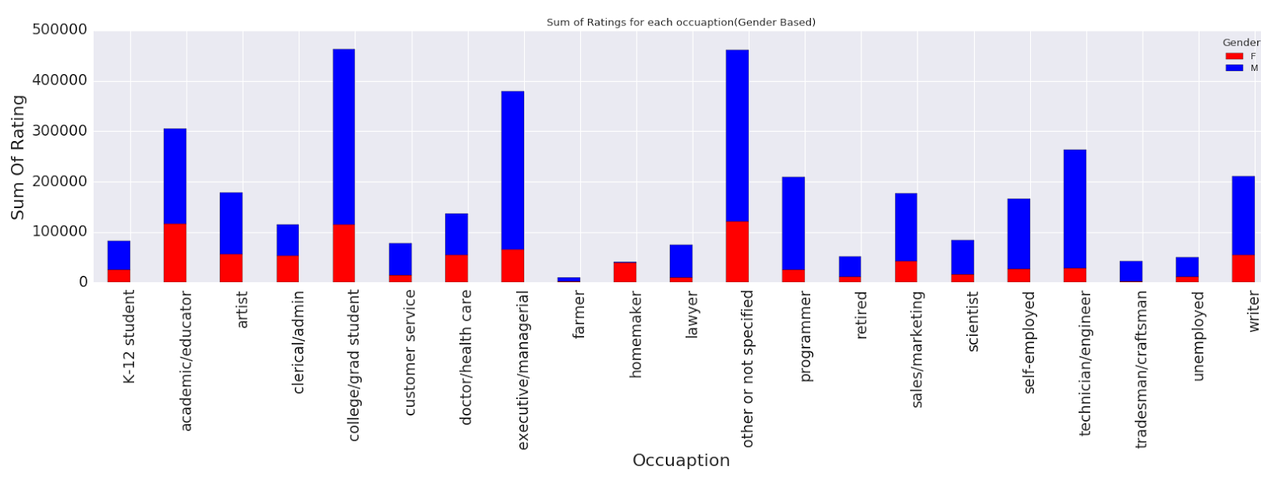
Business Question
Target Audience that the company should consider

Slide 25
Business Question
The genres Animation/Comedy/Thriller are very popular among both the sexes, in order Improve sales, these genre of movies must be promoted

Slide 26

Business Question
Genres that are most disagreed upon and the age groups that disagree the most

Slide 27
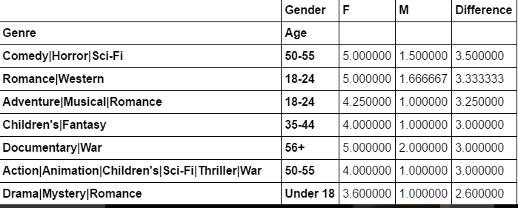
Business Question
The age group 50-55 also show huge disagreement in the genre of movies they prefer, it’s the elderly and the teenagers who contribute in a disagreement.

Slide 28
Business Question
Target Audience

